Slide 1
Reflecting on Practice: Worthwhile Tasks
Session 3
Using Everyday Tasks in Rich Ways

Slide 2
Every single instructional day does not need to be based on a profoundly deep, rich, open task.
There are places in a balanced curriculum that might be better occupied by more everyday tasks.
Notes:
symphonies are not all crescendo, cities are not all landmarks,

Slide 3
Four Task Types
Memorization Procedures
w/Connections
Procedures Doing Mathematics
w/o Connections
Notes:
symphonies are not all crescendo, cities are not all landmarks,

Slide 4
Even very intentionally low threshold tasks require some prior capacity for students to engage.
That capacity is often only built through smaller, more everyday tasks designed specifically to support incremental growth.
Notes:
reflect on the wide range of responses that were generated yesterday to the question of what changes in the step pattern- that was possible because we all have a wide range of mathematical experiences in our background, and a willingness & belief in mathematical play that allows us to productively engage- our students may not arrive in our classes with those mindsets & tools

Slide 5
Let’s look at some typical assignments & see how to maximize their value in providing students with opportunities to learn and in providing teachers with opportunities to make sense of their students’ learning.

Slide 6
List the opportunities to learn for both students & teachers, also make note of the prior knowledge that is required for students to participate in both math prompts.
Notes:
Various ways to implement a task using a sorting protocol, from very open to explicit, well-prescribed categories.

Slide 7
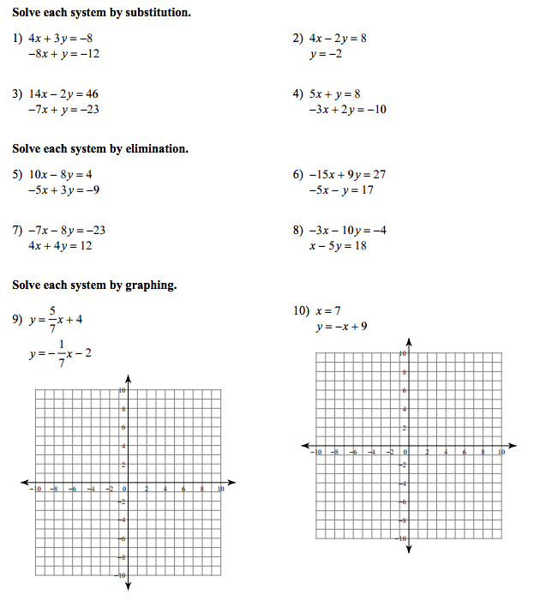
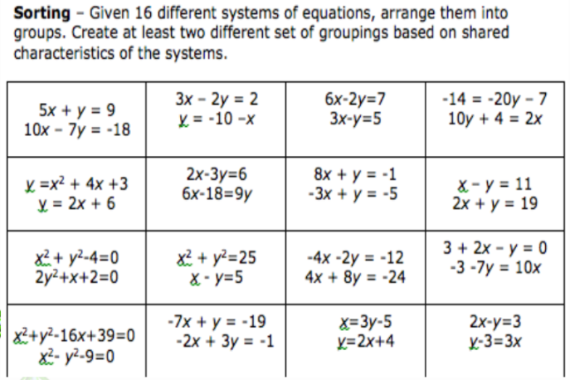
Sorting

Slide 8
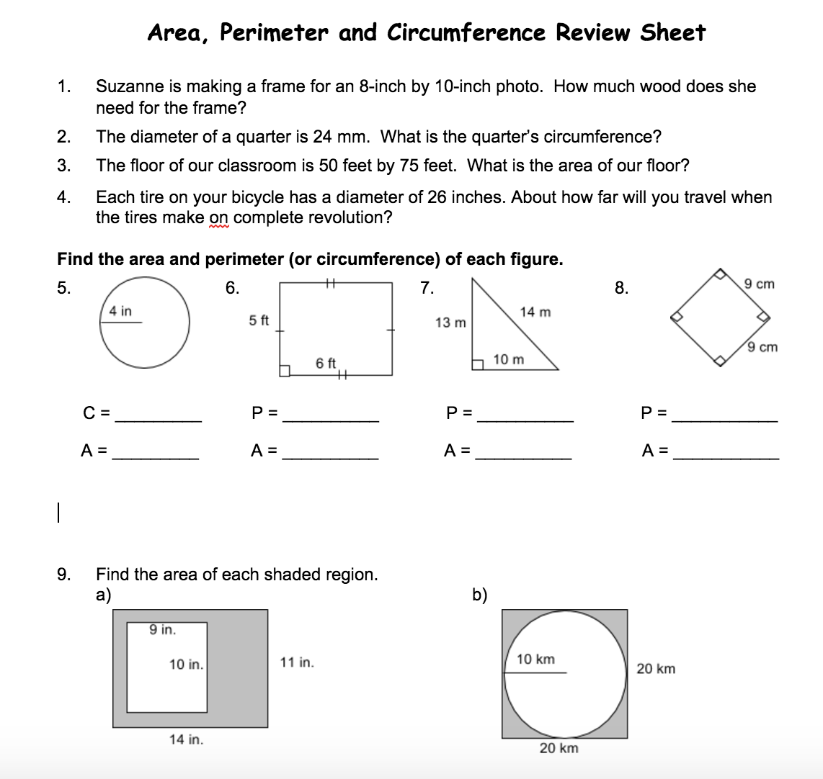
Analysis & reflection
Notes:
could just pass it out to Ss-
could have them work on it in pairs/groups but that often devolves into divide & conquer vs collaborate
could have them do a sort

Slide 9
Possible analysis prompts:
Which 3 problems would be hardest for you & which 3 would be easiest, and why?
Which 3 problems do you think will be most challenging to the most students in our class and why?
Which 3 problems do you think would be most useful to a student preparing for an assessment on this material and why?
Notes:
This question should be omnipresent in teachers’ thinking throughout both planning & instruction

Slide 10
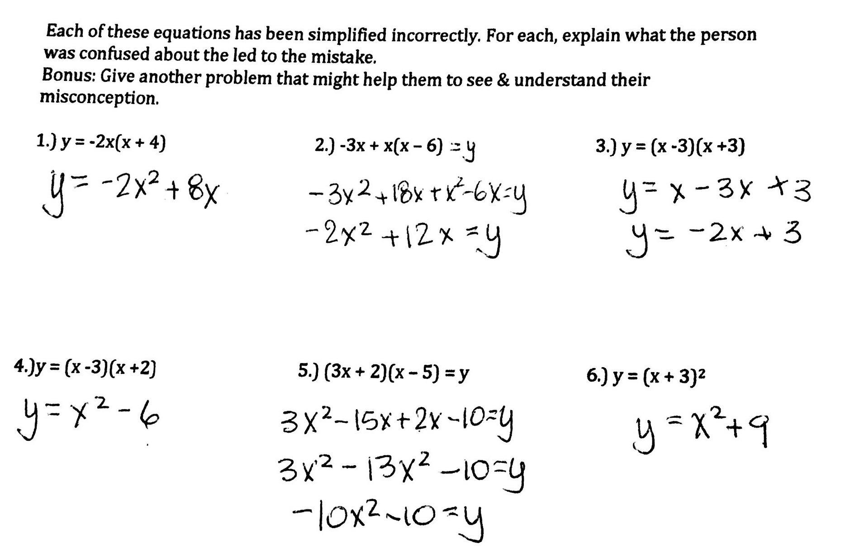
Use the distributive property and combine like terms to rewrite each equation in standard form.
1.) y = -2x(x + 4) 2.) -3x + x(x – 6) 3.) y = (x -3)(x +3)
4.)y = (x -3)(x +2) 5.) (3x + 2)(x – 5) = y 6.) y = (x + 3)²
Using incorrect work

Slide 11
What about this work invites every student in your class to take part in a way that is productive for them and their learning?
Notes:
This question should be omnipresent in teachers’ thinking throughout both planning & instruction

Slide 12
Remember that there is no single right answer about which task to use, or how to implement it.
The right answer is whatever best supports your students in making progress towards your identified mathematical learning goal.
Notes:
This question should be omnipresent in teachers’ thinking throughout both planning & instruction

Slide 13
Looking forward to your own practice…
w/classwork, HW or test prep
what I do now...
what I intend to do differently...
what I anticipate will change and why...
Notes:
This question should be omnipresent in teachers’ thinking throughout both planning & instruction

Slide 14
Good to Great….
Any change in our practice is likely to begin with a drop in productivity.
Expect that things will get worse before they get better.
Give yourself & your students time to re-acclimate.

